Slide 1
Face Entropy Final Presentation
By: Roy Zohar and Roy Mezan

Slide 2
Formalities
Roy Zohar - 209896174
Roy Mezan - 319042800
Instructors:
Prof. Rita Osdachy
Dr. Orr Dunkelman

Slide 3
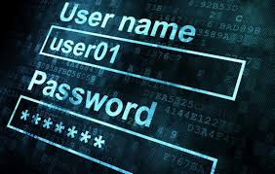
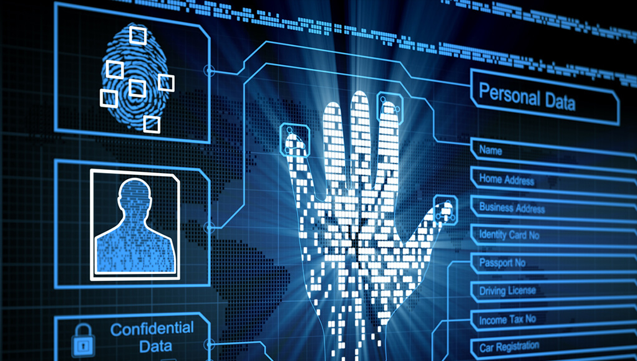
The Problem

Slide 4
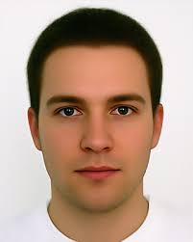
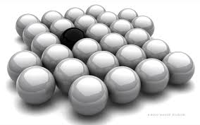
The Problem
Image
Crypto
Good?
DLIB
Deep
Learning
Representation

Slide 5
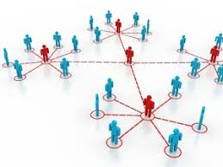
Our Solution
In this project, we proved that the state of the art facial recognition has a very low entropy, which makes it vulnerable to brute force attacks.

Slide 6
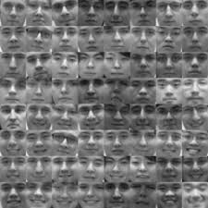
Our Solution
Face space
Representation
Representation
Representation
M

Slide 7
System Features
The full scope of our system is attached in the README.md file and the project submission.
We added dynamic databases with both folders or predetermined CSV files, feature database creator, general logging and random seed logging, retracing mode, visualiztion modes, threshhold testing, and many more research tools.

Slide 8
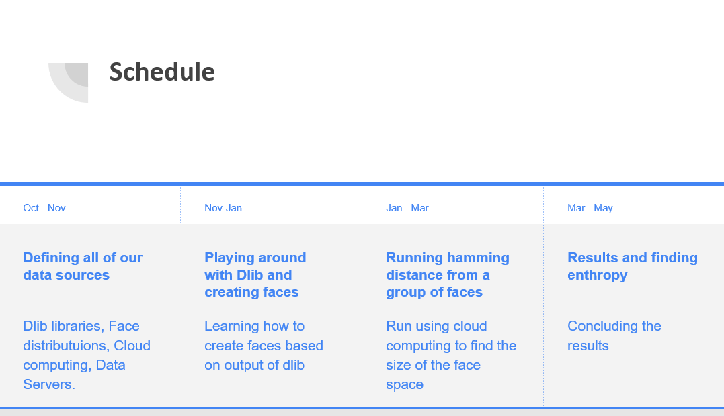
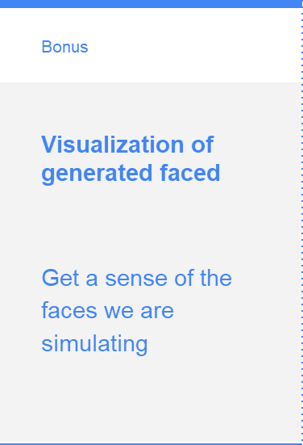
Overall look at our work

Slide 9

Demo

Slide 10
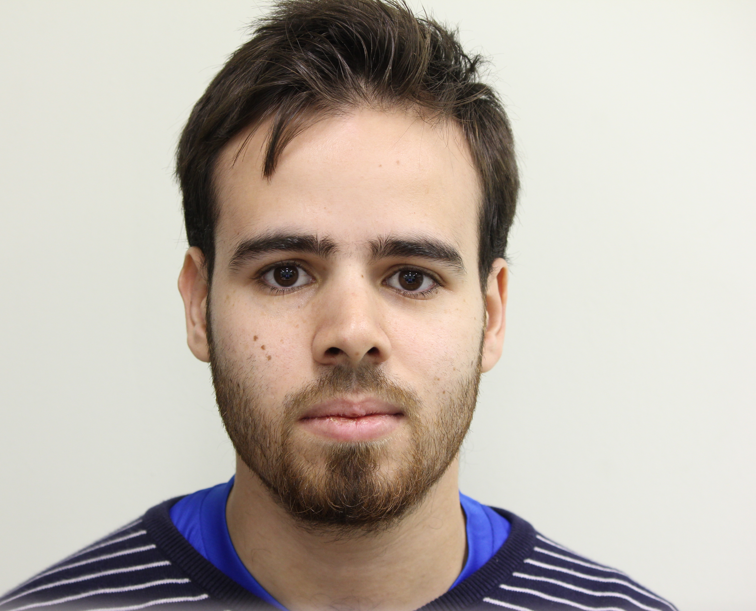
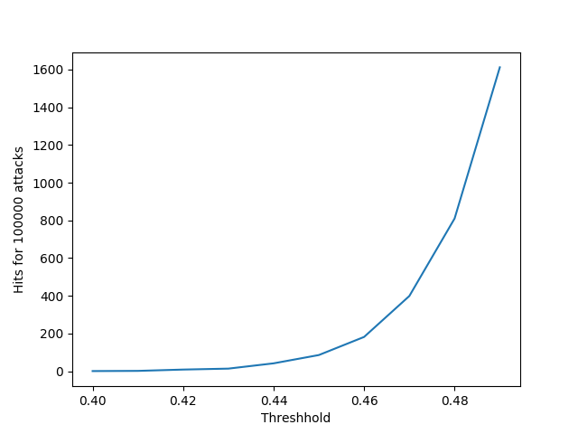
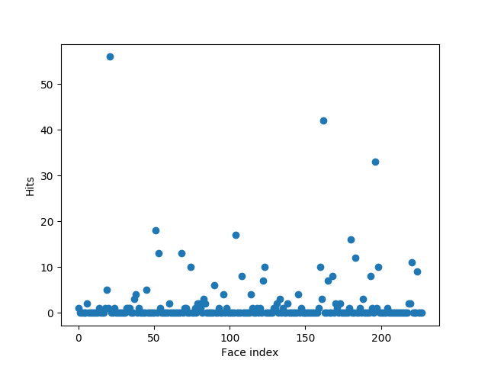
(Disturbing) Results

Slide 11
Future thoughts
After we proved that biometric systems today aren’t so safe, there are 2 main ways we can continue this project:
Attempt to develop better attacks (Bad guys). GANS, Search in clustered areas, “smart search”…
Attempt to develop more featured models (Good guys). “New Dlib”

Slide 12

Thanks for listening!
Questions?

